Slide 1
BRIEFING SESSION (HOAC-HO-51865)
SUPPLY AND DELIVERY OF RECOVERY (TRACK BULLDOZERS, EXCAVATORS AND LOW BED TRAILER) EQUIPMENT WITH A FULL MANAGED MAINTENANCE PLAN FOR A PERIOD OF 7 YEARS.
18 November 2025

Slide 2
Table of Contents
Safety Briefing
Welcome & Introduction
Purpose of the Briefing Session
Tender Process
Evaluation Process
Technical evaluation methodology
Technical
Pricing Schedule
Specific Goals
Questions & Answers
Closure
Before proceeding, all attendees are requested to state their name and company name
to be recorded by the presenter as proof of attendance.

Slide 3
Purpose of The Briefing Session
The purpose of this briefing session is to make sure that all Respondents understand what is expected of them with regards to the RFP process or any other areas that require clarity to the RFP.
01
Minutes/presentation of the briefing session will be distributed to all Respondents in attendance of the briefing session.
02
No questions will be taken during the presentation and will only be accepted under the ‘Questions and Answers’ session. However, all questions must be submitted in writing for a formal written response to be provided by TFR.
03

Slide 4
Tender Process
REQUEST FOR PROPOSAL [RFP] [GOODS/SERVICES]
SUPPLY AND DELIVERY OF RECOVERY (TRACK BULLDOZERS, EXCAVATORS AND LOW BED TRAILER) EQUIPMENT WITH A FULL MANAGED MAINTENANCE PLAN FOR A PERIOD OF 7 YEARS.
RFP NUMBER HOAC-HO-51865
ISSUE DATE: 10 October 2025
CLOSING DATE: 10 November 2025
EXTENTION CLOSING DATE: 11 DECEMBER 2025
CLOSING TIME: 14:00PM
BID VALIDITY PERIOD: 180 Business Days from Closing Date

Slide 5
Tender Process
Respondents must ensure all the required returnable documents are submitted with their proposals – Section 5: PROPOSAL FORM AND LIST OF RETURNABLE DOCUMENTS (RFP page 34 ,35 & 36 of 53). The below documents must be submitted with the bid documents:
MANDATORY RETURNABLE DOCUMENTS | SUBMITTED [Yes/No]
Section 4: Pricing And Delivery Schedule
Pricing schedule that outlines the individual costs associated with different components of the project, such as cost of modifications and cost of delivery.
Delivery schedule that outlines the delivery lead times with start and end date for the customised track bulldozers and the off the shelve excavators and lowbed trailers.
Full managed maintenance cost.

Slide 6
Tender Process (Cont)
Respondents must ensure all the required returnable documents are submitted with their proposals – Section 5: PROPOSAL FORM AND LIST OF RETURNABLE DOCUMENTS (RFP page 35 of 53). The below documents must be submitted with the bid documents:
RETURNABLE DOCUMENTS USED FOR SCORING | SUBMITTED [Yes or No]
Valid proof of Respondent’s compliance to Specific Goals requirements stipulated in Section 9 of this RFP (Valid B-BBEE certificate or Sworn- Affidavit as per DTIC guidelines)
B-BBEE Level of contributor – Level 1 or 2- B-BBEE Certificate / Sworn- Affidavit / B-BBEE CIPC Certificate (in case of JV, a consolidated scorecard will be accepted) as per DTIC guideline.
At least 30% Black women Owned entities - B-BBEE Certificate / Sworn- Affidavit / B-BBEE CIPC Certificate (in case of JV, a consolidated scorecard will be accepted) as per DTIC guideline.
Entities that are at least 51% Black Owned - CI B-BBEE Certificate / Sworn- Affidavit / B-BBEE CIPC Certificate (in case of JV, a consolidated scorecard will be accepted) as per DTIC guideline.
Creation of new jobs and labour intensification - Section 10: Job Creation Schedule Returnable documents (of the RFP)
Delivery schedule that outlines the delivery lead times with start and end date for the customised track bulldozers and the off the shelve excavators and lowbed trailers.
Fully managed equipment maintenance plan outlining both planned maintenance (service) and unplanned maintenance (repairs) schedules.
Entity’s financial stability

Slide 7
Tender Process
Respondents must ensure all the required returnable documents are submitted with their proposals – Section 5: PROPOSAL FORM AND LIST OF RETURNABLE DOCUMENTS (RFP page 36 of 53).
ESSENTIAL RETURNABLE DOCUMENTS & SCHEDULES | SUBMITTED [Yes or No]
In the case of Joint Ventures, a copy of the Joint Venture Agreement or written confirmation of the intention to enter into a Joint Venture Agreement
Latest Financial Statements signed by your Accounting Officer or latest Audited Financial Statements plus 2 previous years
Section 1: SBD1 Form
SECTION 5: Proposal Form and List of Returnable documents
SECTION 6: Certificate Of Acquaintance with RFP, Terms & Conditions & Applicable Documents
SECTION 7: RFP Declaration and Breach of Law Form
SECTION 9: Specific goals points claim form
SECTION 10: Job-Creation Schedule Note: Job creation schedule will be evaluated under specific goals as per Section 9: Specific Goals points claim form. Job Creation Plan is required as an essential returnable document Bidders are to note that job creation plan will not be for evaluation purpose but will be negotiated with the winning bidder at the time of award. Section 2 - Notice To Bidders, Number 4
SECTION 11: Protection of Personal Information
ANNEXURE K - Possible Subcontracting A subcontracting a minimum 30% to an EME (Exempted Micro Enterprise) and QSE (Qualifying Small Enterprise).
Proof Of CSD Registration
Proof Of Tax Compliance

Slide 8
Tender Process (Cont)
The deadline for questions /clarifications is before 16:00 on the 8th of December 2025. clarifications can be directed to Emmanuel Moriri via e-mail:- Emmanuel.Moririi@transnet.net
Response to questions / bid clarifications will be sent to all Respondents who attended the briefing session.
Proposals / tender documents have to be submitted on or before the tender closing, which is 14h00 pm (Central Africa Time), 11th of December 2025 at www.etenders.gov.za and transnetetenders.azurewebsites.net.
No late submissions will be accepted.
All documents submitted must be cross referenced to the relevant section of the RFP

Slide 9
Tender process (cont.)
For specific clarification relating to this RFP, an RFP Clarification Request Form should be submitted to [Emmanuel Moriri] before 16:00pm on 08th December 2025, substantially in the form set out in Section 8 hereto. In the interest of fairness and transparency, Transnet’s response to such a query will be published on the e-tender portal and Transnet website
Specific complaints relating to this RFP before or after the closing date should be formally submitted by emailing to groupscmcomplaints@transnet.net. Once the complaint has been submitted, the Transnet SCM Complaints office will acknowledge your complaint and send you a complaint form for completion.
After the closing date of the RFP, a Respondent may only communicate with the name of delegated individual (BEC chairperson), at email Emmanuel.Moriri@Transnet.net on any matter relating to its RFP Proposal.

Slide 10
Evaluation process
Transnet will utilize the following methodology and criteria in selecting a preferred Service provider, if so required:

Slide 11
Technical Evaluation Methodology
STEP TWO: Minimum Threshold 75% points for Technical Assessment Criteria and Minimum Threshold 60% points for technical expertise and previous experience assessment.
Failure to achieve the 75% and 60% threshold will lead to disqualification and will not progress to the next stage of the evaluation The test for the Technical and Functional threshold is attached as Annexure B (Technical Evaluation Criteria) Category A step 1 and step 2. And Annexure C (Technical Evaluation Criteria) Category B step 1 and step 2. Bidders will be scored according to attached Annexure D (Technical scoring matrix).
The test for the technical and functional threshold for Category A Step 1 (Track Bulldozers) will include the following:
Technical Evaluation Criteria: | Points Weightings
Technical Functionality: Track Bulldozer Design and Functionality | 60%
Fully Managed Equipment Maintenance plan (planned and unplanned maintenance) | 40%
Total Weighting: | 100%
Minimum qualifying score required: | 75%
Respondents are to note that Transnet will round off final technical scores to the nearest 2 (two) decimal places for the purposes of determining whether the technical threshold has been met.

Slide 12
Technical Evaluation Methodology
The test for the technical expertise and previous experience threshold for Category A Step 2 (Track Bulldozers) will include the following:
Technical Evaluation Criteria: | Points Weightings
Training Capability and Capacity | 20%
Company’s previous work experience with similar scope | 15%
Capability, knowledge and individual experience of key personnel involved in project. | 30%
Delivery period | 35%
Total Weighting: | 100%
Minimum qualifying score required: | 60%
The test for the technical and Functional threshold for Category B Step 1 (Excavators and Lowbed) will include the following:
Technical Evaluation Criteria: | Points Weightings
Delivery Lead Times | 60%
Fully Managed Equipment Maintenance plan (planned and unplanned maintenance) | 40%
Total Weighting: | 100%
Minimum qualifying score required: | 75%
Respondents are to note that Transnet will round off final technical scores to the nearest 2 (two) decimal places for the purposes of determining whether the technical threshold has been met.

Slide 13
Technical Evaluation Methodology (cont.)
The test for the technical expertise and previous experience threshold for Category B Step 2 (Excavators and Lowbed) will include the following:
Technical Evaluation Criteria: | Points Weightings
Training Capability and Capacity | 25%
Company’s previous work experience with similar scope | 15%
Capability, knowledge and individual experience of key personnel involved in project. | 25%
Equipment Compatibility | 35%
Total Weighting: | 100%
Minimum qualifying score required: | 60%
Respondents are to note that Transnet will round off final technical scores to the nearest 2 (two) decimal places for the purposes of determining whether the technical threshold has been met.

Slide 14
Technical: Briefing Session RECOVERY (TRACK BULLDOZERS
21 January 2025
14

Slide 15
Background of the Project
Transnet Freight Rail (TFR) is a division of Transnet, South Africa's state-owned freight transport and logistics company. Its main role is to manage and operate the freight rail services in South Africa. TFR is divided into Coal, Iron Ore, MMC, Manganese, ABL/CAB and SAC business units (BU’s). The 6 BU’s are responsible for transporting a variety of goods across the country, ranging from minerals, coal, and agricultural products, among others. All the 6 TFR BU’s are responsible for moving specified tonnages yearly, taking the 2022/2023 FY target was 202mtpa and only achieved 149 Mtpa. In the 2023/2024 FY, TFR target was 194mtpa and only 151mtpa was achieved.
TFR did not meet the specified target due to various factors including derailment, cable theft, network, locomotive failure, among other operational disruptions. For this project, the focus will be on improving Transnet Engineering (TE) response time during derailment recovery. In TFR, derailment refers to the situation where a train goes off its rail tracks. This can happen due to a variety of factors, such as track defects, equipment failure, or human error, and it often leads to significant disruptions and potential hazards which leads to loss of tonnages due to downtime experienced. When derailment occurs, rail operations on the affected section need to be stopped until the incident is investigated, cleared and track restored to operational standard. On the clearance, TFR is depended on TE to deploy the breakdown (recovery) equipment(s) to the site and clear the rolling stock on the derailment section, which then allows Rail Network Construction (RNC) to restore the track and open the line.

Slide 16
The scope of the project is to supply and deliver already customised recovery track bulldozers and the off the shelve excavators and lowbed trailers as per the specification in Annexure A with 7 000hours/7 years fully managed maintenance plan to minimize disruption to operation and ensure prompt recovery during derailment.
SCOPE OF REQUIREMENTS
Equipment | Quantity | Key Deliverables
Customised Recovery Track Bulldozer | 8 | Refer to the specifications attached to this document.
Recovery Excavators (20 ton) | 6 | Refer to the specifications attached to this document.
Lowbed Trailers (80 ton) | 3 | Refer to the specifications attached to this document.

Slide 17
SCOPE OF REQUIREMENTS
The off-shelf equipment should be delivered in 6 months within the current financial year and the equipment that requires customisation should be delivered before the end of the financial year 2027/28. Transnet reserve the right to withdraw the contract at no cost provided the contractor fails to deliver the first track bulldozer within the specified time frame. Table below indicate the high-level project deliverables.
High Level Project Deliverables | Duration | Year
1. Procurement of excavators and lowbed trailers Manufacturing excavators and lowbed trailers Delivery, Pretesting and commissioning of all 6 excavators and 3 lowbed trailers. | 4 months 2 months | Year 1
2. Procurement of track bulldozers Design reviews and design freeze Manufacturing and development of the first track bulldozer Delivery and pretesting of the first track bulldozer. | 2 months 5 months 3 Months
Manufacturing all track bulldozers Pretesting and commissioning Handover of all track bulldozers | 7 months 3 Months 2 Months | Year 2

Slide 18
Recovery Track Bulldozers
The recovery track bulldozers are used in a derailment site to lift or pull the wagons away from the rail track if the wagon is damaged. And if the wagon can still be used, the track bulldozers assist in putting the wagon back on track. Normally the track bulldozers are operated in pairs of 2 depending on each scenario to pull the rolling stock. The technical requirement for the track bulldozers is outlined in the attached specification in Annexure A:

Slide 19
Recovery Excavators and Lowbed Trailers
19

Slide 20
Recovery Excavators and Lowbed Trailers
The excavators are used in a derailment site to put back the commodity into the wagon in case of a spillage and to offload the commodity from the derailed wagon in a case where the wagon is totally damaged. The lowbed trailers will be used to transport excavators and track bulldozers via road. The technical requirements for excavators and lowbed trailers are as per the attached specification in Annexure A:
The excavators, low bed trailer and track bulldozers should be easy to maintain and the spares parts should be available for maintenance and sustainability with a proven local technical support availability.
The excavators, low bed trailer and track bulldozers must come with 7 000 hours/ 7-years maintenance plan whichever comes first.
The excavators, low bed trailer and track-track bulldozers must be able to operate and withstand all weather conditions.

Slide 21
Recovery Excavators and Lowbed Trailers
The recovery equipment to be delivered should comply to the following but not limited to regulatory requirements and standards:
Code of Practice 29 (COP29): The code pertains to the safe management of lifting equipment and requirements with regard to the procurement of the lifting equipment which must be complied with (section 17).
Occupational Health and Safety, Act no 85 of 1993 and regulation: (Driven Machinery Regulation section 18). The regulation pertains to the requirements and management of the lifting equipment.
Railway Safety Regulator (RSR): Promote safe railway operations through appropriate support, monitoring, and enforcement guided by an enabling regulatory framework.
SANS 1395:1 Road Transport Management Systems (RTMS) standard stipulates requirements for the implementation of a management system that demonstrates compliance with Road Traffic Regulations and contributes to preserving road infrastructure, improving road safety, ensuring driver health and wellness, and improving productivity.
SAE J397 OCT95, SAE J1040 MAY94, ISO 3164:1995, ISO 3471:1994 for rollover protection.
SAE J231 JAN81, ISO 3449:1992 for falling object protection.
SAE J1026 APR90, ISO 10265:1998 for brakes standard.
ANSI/SAE J1166 MAY90: standard for noise levels

Slide 22
IMPLEMENTATION REQUIREMENTS
Once the contract has been awarded to the successful bidder, it is imperative that a kick off meeting is held within 7 working days of awarding. The awarded bidder will be required to implement the following:
Conduct pretest after equipment manufacturing to validate equipment performance.
Conduct acceptance field test of the complete units of the track bulldozers at Transnet site during commissioning.
Given the specialised nature of the recovery equipment, the awarded bidder shall be responsible for the development and delivery of comprehensive training material and training on the operation and maintenance of recovery bulldozers and excavators. This must include the following:
Detailed training manuals, presentations, and any other relevant materials tailored to the specific recovery equipment supplied.
Training materials must be developed in conjunction with Transnet School of Engineering to ensure that the training material aligns to Transnet standards.
Provide theoretical and practical training to a total of 20 Transnet employees, including designated trainers from the Transnet School of Engineering.
Training should be for a duration of 2 months for excavators and 2 months for recovery track Bulldozers and this should be before the handover of the equipment to Transnet.
Upon successful completion of the training, formal certificates of competency shall be issued to all participants. Certification must be recognized and valid for internal use and future training rollouts.
Sign off a fully managed maintenance agreement with Transnet according to the scope and requirements of the project.

Slide 23
HOAC-HO-51865 SUPPLY AND DELIVERY OF RECOVERY (TRACK BULLDOZERS, EXCAVATORS AND LOW BED TRAILER) EQUIPMENT WITH A FULL MANAGED MAINTENANCE PLAN FOR A PERIOD OF 7 YEARS
Supplier Development Inputs : Presented by the TFR ESD Team (Bella Maja& Nhlakanipho Mbuyane)
18 November 2025

Slide 24
SPECIFIC GOALS
B-BBEE
B-BBEE Definition:
Broad-Based Black Economic (B-BBEE) means the economic empowerment of all black people including women, workers, youth, people living with disabilities and people living in rural areas through diverse but integrated socio-economic strategies.
Purpose:
To increase the number of black people that manage, own and control enterprises and productive assets.
To facilitate ownership and management of enterprises and productive assets by communities, workers, cooperatives and other collective enterprises
To achieve an equitable representation in all occupational categories and levels in the workforce
To procure from large, medium and small sized black owned enterprises
To increase investment in enterprises and communities that are owned and managed by black people
A valid B-BBEE certificate for LE company’s OR an Affidavit for QSE and EME’s is required
B-BBEE Amended Codes Principles
Enhanced the recognition status of black owned EMEs and QSEs
An EME that is 100% owned by black people qualifies as a level 1 contributor;
An EME that is more than 51% owned by black people qualifies as a level 2 contributor;
No verification requirements for EMEs; EME to obtain a Sworn affidavit or a CIPC Certificate

Slide 25
PREFERENTIAL PROCUREMENT REGULATIONS 2022
PPPFA provides for a preference points system in terms of which contracts below a prescribed value be evaluated on the basis that 20 out of 100 possible points must be allocated to “specific goals” and 80 points allocated to price.
For contracts above a prescribed value, 10 out of 100 possible points must be allocated to “specific goals”, and 90 points allocated to price
The applicable preference point system as envisaged
The specific goal in the invitation to submit the tender for which a point may be awarded, and the number of points that will be awarded to each goal, and proof of the claim for such goal .
Bidders who do not submit B-BBEE Status Level Verification Certificates or applicable affidavit copy will be deemed as non-compliant contributors to B-BBEE will score zero for preference points .
This also applies to Bidders who submit letters or expired certificates indicating that their B-BBEE status is in the process of being verified. Where a B-BBEE certificate is to be used for scoring purposes only, such letters indicating that their B-BBEE status is in the process of being verified or expired certificates are submitted, bidders will be scored zero for preference points.

Slide 26
JOINT VENTURE (JV)
In 2019 DTI released amendments to the Codes of Good Practice. Joint Ventures are referred to in Revised Code 000, Statement 000: General Principles
As per paragraph 7 of Amended Code Series 000, Statement 000 of the Codes of Good Practice, unincorporated joint ventures are required to compile a consolidated verification certificate. A consolidated verification certificate will consolidate the verified compliance data of joint venture partners if those Measured Entities were a single Measured Entity.
A JV will require its own Broad-Based Black Economic Empowerment (B-BBEE) certificate if they would like to tender or enter into a contract that requires a B-BBEE Certificate.
A trust, consortium or joint venture (including unincorporated consortia and joint ventures) must submit a consolidated B-BBEE Status Level verification certificate for every separate bid.
A tenderer failing to submit proof of B-BBEE status level of contributor or is a non-compliant contributor to B-BBEE may not be disqualified, but may only score points out of 90 for price and (b) scores 0 points applying the 90/10 principle . Refer PPPFA No. 40553 for more info on preference point.
Note the following:
• A consolidated verification certificate is required. • The consolidation is based on the weighting as defined in the joint venture agreement. • The respective scores are weighted according to their proportionate share in the joint venture. • A joint venture certificate is valid for 12 months and only applicable to a specific project.
Eligibility of a Joint Venture
Joint Ventures are required to compile a consolidated verification certificate. A consolidated verification certificate will consolidate the verified compliance data of joint venture partners in accordance .

Slide 27
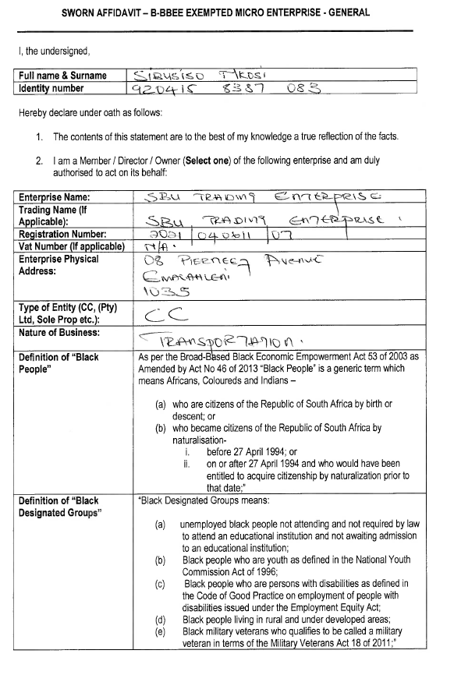
VALID SWORN AFFIDAVIT
Name of respondent and enterprise details
Select one either Member/ Director/ Owner
Enterprise Name, Registration Number =VAT no. If Vat registered, Enterprise address
Example:
VALID SWORN AFFIDAVIT

Slide 28
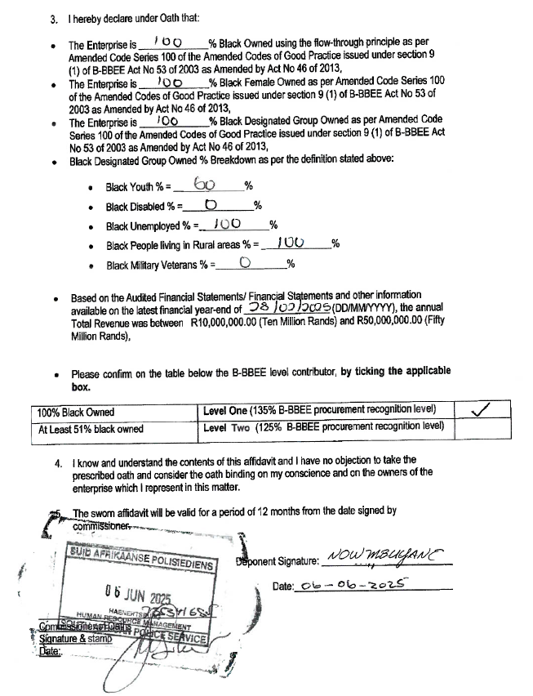
VALID SWORN AFFIDAVIT
Example:
VALID SWORN AFFIDAVIT
Annual Total Revenue and Level of Black Ownership and Black Women Ownership
B-BBEE Status Level based on Black Ownership
DATE BY BOTH DEPONENT AND COMMISSIONER OF OATH MUST BE THE SAME
FUL NAME, BUSINESS ADDRESS AND STATE DESIGNATION
Deponent signature and date
Commissioner of Oath signature and stamp were applicable
Certification Signature and/or Stamp

Slide 29
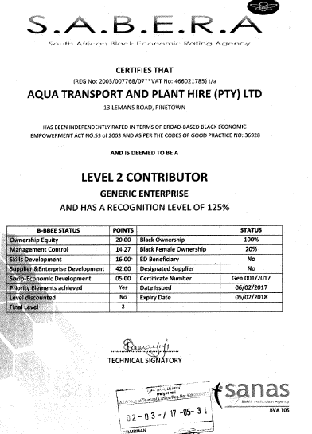
VALID B-BBEE CERETIFICATE
Example:
VALID B-BBEE
Enterprise Name
(Cross referenced to Tax Clearance Certificate &
Enterprise Registration No.)
COMPANY NAME
a
BBBEE level based on QSE/LE (Generic status)
a
Elements verified
Validity Period
a
Accreditation agency and BVA Number

Slide 30
CONDITIONS OF CONTRACT (JOB CREATION AND SUBCONTRACTING)
Where Transnet has identified opportunities of economic transformation and empowerment, Transnet will incorporate a contractual obligation for the winning bidder to execute the identified transformation objective as a condition of contract.
Each bidder interested in participating in this tender should be cognizant that it is a condition of contract the winning bidder will be required to contract with Transnet on one or more of the following transformation initiatives:
Job creation and preservation (Page 50 of 53 of the RFP)
Subcontracting (Annexure K)

Slide 31
CONDITIONS OF CONTRACT (JOB CREATION) (Page 50 of 53 of the RFP)
Job creation and preservation
Job Creation Plan is required as an essential returnable document.
Note:
Bidders are to note that job creation plan will not be for evaluation purpose but will be negotiated with the winning bidder at the time of award.
The bidder must acknowledge its responsibility to actively support and implement initiatives that advance Broad-Based Black Economic Empowerment (B-BBEE), Job in alignment with applicable Government policies and Transnet’s strategic priorities.
The bidder must submit a detailed plan on how to the initiatives will be implemented and will be monitored by ESD. Transnet Freight Rail reserves the right to negotiate these initiatives over and above the specific set above.
A percentage of the contract value will be determined and reserved for the advancement of designated groups through job opportunities. The percentage determined shall not be lower than 10% of the total contract value.
The bidders must note that THE INCLUSION OF SUBCONTACTING AS A CONDITION OF CONTRACT REQUIREMENT CANNOT BE USED FOR PURPOSES OF EVALUATION.

Slide 32
CONDITIONS OF CONTRACT (POSSIBLE SUBCONTRATING OPPORTUNITIES) ANNEXURE K
The bidder will be required to sub-contract a minimum of 30%.
The bidder must submit a detailed plan on how to the initiatives will be implemented and will be monitored by ESD.
Transnet Freight Rail reserves the right to negotiate these initiatives over and above the specific set above.
Subcontracting as a condition of contract for contracts above 10 million: A minimum of 30% mandatory subcontracting to contracts with a total value of 10 million and above.
If an opportunity has been identified to apply subcontracting as a condition of the contract to advance certain designated groups in a transaction. A subcontracting a minimum 30% to an EME (Exempted Micro Enterprise) and QSE (Qualifying Small Enterprise) which is:
At least 51% owned by black people
At least 51% owned by black people who are youth
At least 51% owned by black people who are women
At least 51% owned by black people with disabilities
51% owned by black people living in the rural or underdevelopment areas or townships
A co-operative which is at least 51% owned by black people
The bidders must note that THE INCLUSION OF SUBCONTACTING AS A CONDITION OF CONTRACT REQUIREMENT CANNOT BE USED FOR PURPOSES OF EVALUATION.

Slide 33
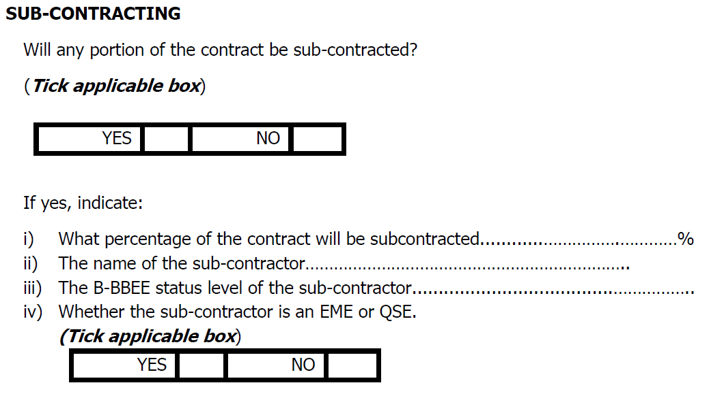
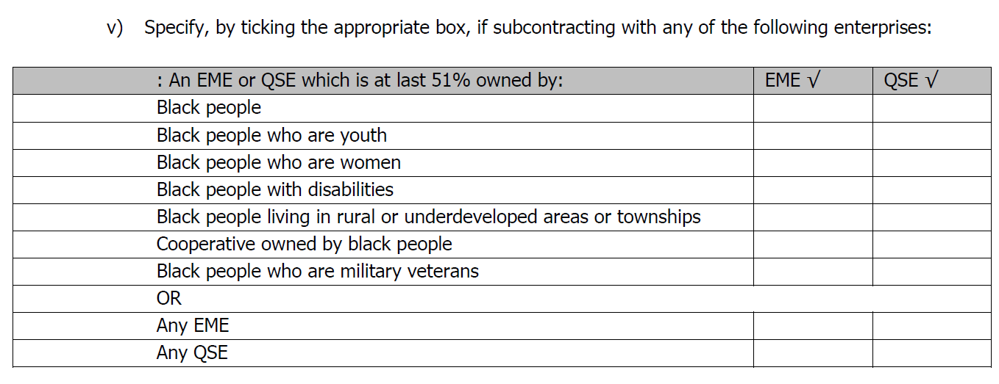
SUBCONTRACTING SPECIFIC GOALS POINTS CLAIM FORM AS PAGE 47 OF 53, SECTION 9

Slide 34
EVALUATIONS & MAXIMUM POINTS
Selected Specific Goal | Number of points allocated (20) | Number of points allocated (10)
B-BBEE Level of contributor 1 or 2 | 8 | 4
At least 30% Black women Owned entities | 4 | 2
Entities that are at least 51 % Black Owned | 4 | 2
Creation of jobs and labour intensification | 4 | 2
Non-Compliant and/or B-BBEE Level 3-8 contributors | 0 | 0

Slide 35
SPECIFIC GOALS EVIDENCE
Specific Goals | Acceptable Evidence
B-BBEE | B-BBEE Certificate / Sworn- Affidavit / B-BBEE CIPC Certificate (in case of JV, a consolidated scorecard will be accepted) as per DTIC guideline
Entities that are at least 30% Black Women Owned | B-BBEE Certificate / Sworn- Affidavit / B-BBEE CIPC Certificate (in case of JV, a consolidated scorecard will be accepted) as per DTIC guideline
Entities that are at least 51 % Black Owned | CI B-BBEE Certificate / Sworn- Affidavit / B-BBEE CIPC Certificate (in case of JV, a consolidated scorecard will be accepted) as per DTIC guideline
Creation of jobs and labour intensification | Section 10: Job Creation Schedule Returnable documents ( of the RFP)

Slide 36

Questions & Answers
Before accepting questions, all attendees are requested to repeat their name and company name and provide their email address, to be recorded by the presenter as proof of full attendance.
An e-mail confirming attendance will then be sent to the address provided as proof of attendance.
Bids without this e-mail will be rejected. Bidders are advised to expect this e-mail and to approach the presenter if this e-mail is not received.
Questions & Answers

Slide 37
THANK YOU

